Slide 1
CSE 219: Digital Logic & Computer Design
Tamanna Haque Nipa
Assistant Professor
Dept. of CSE
Stamford University Bangladesh

Slide 2


Half-Adder
A
B
Two inputs A & B
Two outputs C_{out} & Sum
A | B | C_{out} | Sum
0 | 0 | 0 | 0
0 | 1 | 0 | 1
1 | 0 | 0 | 1
1 | 1 | 1 | 0
Sum
A⁰B
C_{out}
AB⁰
AB
0 + 0 = 0
Equations:
0 + 1 = 1
1 + 0 = 1
Sum= A⁰B +AB⁰ = A ⊕ B
1 + 1 = 1 0
C_{out}= AB

Slide 3
Full-Adder
Three inputs A, B & C_{in}
Two outputs C_{out} & Sum
A 0
A | B | C_{in}
0 | 0 | 0
0 | 0 | 1
0 | 1 | 0
0 | 1 | 1
1 | 0 | 0
1 | 0 | 1
1 | 1 | 0
1 | 1 | 1
C_{out} | Sum
B 0
0 | 0
C_{in} 1
0 | 1
1
0 | 1
A 0
A 1
1 | 0
B 1
B 1
0 | 1
C_{in} 1
C_{in} 1
1 | 0
1 0
1 1
1 | 0
1 | 1

Slide 4
Full-Adder
A | B | C_{in} | C_{out} | Sum
0 | 0 | 0 | 0 | 0
0 | 0 | 1 | 0 | 1
0 | 1 | 0 | 0 | 1
0 | 1 | 1 | 1 | 0
1 | 0 | 0 | 0 | 1
1 | 0 | 1 | 1 | 0
1 | 1 | 0 | 1 | 0
1 | 1 | 1 | 1 | 1
A⁰B⁰C_{in}
A⁰BC⁰_{in}
A⁰BC_{in}
AB⁰C⁰_{in}
AB⁰C_{in}
ABC⁰_{in}
ABC_{in}
ABC_{in}
Sum = A⁰B⁰C_{in} + A⁰BC⁰_{in} + AB⁰C⁰_{in} + ABC_{in}
Cout = A⁰BC_{in} + AB⁰C_{in} + ABC⁰_{in} + ABC_{in}

Slide 5
Full-Adder
Sum = A⁰B⁰C_{in} + A⁰BC_{in}⁰ + AB⁰C_{in}⁰ + ABC_{in}
= A⁰(B⁰C_{in} + BC⁰_{in}) + A(B⁰C⁰_{in} + BC_{in})
= A⁰(B ⊕ C_{in}) + A(B ⊕ C_{in})⁰
= A ⊕ (B ⊕ C_{in})
C_{out} = A⁰BC_{in} + AB⁰C_{in} + ABC⁰_{in} + ABC_{in}
= C_{in}(A⁰B+AB⁰) + AB(C⁰_{in} + C_{in} )
= C_{in}(A ⊕ B) + AB

Slide 6

Full-Adder
Sum = A ⊕ (B ⊕ C_{in})
= (A ⊕ B )⊕ C_{in}
C_{out} = C_{in}(A ⊕ B) + AB
A
B
C_{in}
Sum
C_{out}

Slide 7
Full-adder implementation with half-adders
Half-Adder
Full-Adder
Sum= A ⊕ B
Sum = (A ⊕ B ) ⊕ Cin
C_{out}= AB
C_{out} = C_{in}(A ⊕ B) + AB
A⊕B
Half-Adder
(A ⊕ B ) ⊕ C_{in} = Sum
A
Half-Adder
AB
C_{in}(A ⊕ B)
B
C_{out}
C_{in}

Slide 8
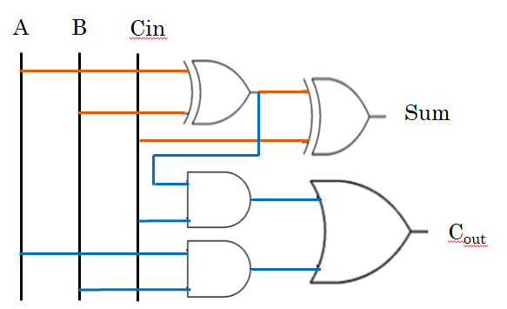
4 bit Parallel Adder
B
A
Full Adder
C_{out}
C_{in}
Cin =0
Sum
A3 A2 A1 A0
B3 B2 B1 B0
Cout
S3 S2 S1 S0

Slide 9
4 bit Parallel Adder
B3
A3
B2
A2
B1
A1
B0
A0
FA 3
FA 2
FA 1
FA 0
Cout
Cin = 0
S3
S2
S1
S0

Slide 10
4 bit Parallel Adder
B3
A3
B2
A2
B1
A1
B0
A0
FA 3
FA 2
FA 1
FA 0
Cout
Cin = 0
S3
S2
S1
S0

Slide 11
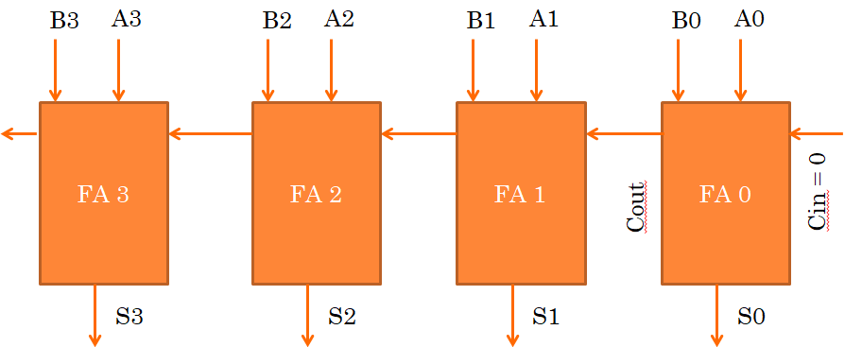
4 bit Parallel Adder (Ripple Adder)
B₃ B₂ B₁ B₀
A₃ A₂ A₁ A₀
4 bit Full Adder
Cout
Cin = 0
S₃ S₂ S₁ S₀
Cin =0
1
1
1
Cin =0
A3 A2 A1 A0
0 1 0 1 = 5
B3 B2 B1 B0
0 1 1 1 = 7
Cout
S3 S2 S1 S0
1 1 0 0 = 12
Cout = 0

Slide 12








Half-Subtractor
A
B
Two inputs A & B
Two outputs B_{in} & Difference
A | B | B_{in} | Diff
0 | 0 | 0 | 0
0 | 1 | 1 | 1
1 | 0 | 0 | 1
1 | 1 | 0 | 0
Diff
A⁰B
A⁰B
B_{in}
AB⁰
Equations:
Diff= A⁰B +AB⁰ = A ⊕ B
B_{in}= A⁰B

Slide 13
Full-Subtractor
Three inputs A, B & B_{out} (Borrow out)
Two outputs B_{in} (Borrow in) & Difference
A 0
+10
8 3
1 5
A | B | B_{out}
0 | 0 | 0
0 | 0 | 1
0 | 1 | 0
0 | 1 | 1
1 | 0 | 0
1 | 0 | 1
1 | 1 | 0
1 | 1 | 1
B_{in} | Diff
B 0
1+
0 | 0
+
B_{out} 1
6
8
1 | 1
1
1
1 | 1
A 0
A 0
1 | 0
B 1
B 1
B_{out} 0
B_{out} 1
1 1
1 0

Slide 14
Full-Subtractor
Three inputs A, B & B_{out} (Borrow out)
Two outputs B_{in} (Borrow in) & Difference
A 1
+10
8 3
1 5
A | B | B_{out}
0 | 0 | 0
0 | 0 | 1
0 | 1 | 0
0 | 1 | 1
1 | 0 | 0
1 | 0 | 1
1 | 1 | 0
1 | 1 | 1
B_{in} | Diff
B 0
1+
0 | 0
B_{out} 0
6
8
1 | 1
0 1
1 | 1
A 1
A 1
+2
1 | 0
B 0
B 1
2
0 | 1
B_{out} 1
B_{out} 1
0 | 0
0 0
1 1
0 | 0
1 | 1

Slide 15
Full-Subtractor
A | B | B_{out} | B_{in} | Diff
0 | 0 | 0 | 0 | 0
0 | 0 | 1 | 1 | 1
0 | 1 | 0 | 1 | 1
0 | 1 | 1 | 1 | 0
1 | 0 | 0 | 0 | 1
1 | 0 | 1 | 0 | 0
1 | 1 | 0 | 0 | 0
1 | 1 | 1 | 1 | 1
A⁰B⁰B_{out}
A⁰B⁰B_{out}
A⁰BB⁰_{out}
A⁰BB⁰_{out}
A⁰BB_{out}
AB⁰B⁰_{out}
ABB_{out}
ABB_{out}
Diff = A⁰B⁰B_{out} + A⁰BB⁰_{out} + AB⁰B⁰_{out} + ABB_{out}
B_{in} = A⁰B⁰B_{out} + A⁰BB⁰_{out} + A⁰BB_{out} + ABB_{out}

Slide 16
Full-Subtractor
Diff = A⁰B⁰B_{out} + A⁰BB⁰_{out} + AB⁰B⁰_{out} + ABB_{out}
= A⁰(B⁰B_{out} + BB⁰_{out}) + A(B⁰B⁰_{out}+BB_{out})
= A⁰(B ⊕ B_{out}) + A(B ⊕ B_{out})⁰
= A ⊕ (B ⊕ B_{out})
B_{in} = A⁰B⁰B_{out} + A⁰BB⁰_{out} + A⁰BB_{out} + ABB_{out}
= A⁰(B⁰B_{out} + BB⁰_{out}) + B B_{out}(A⁰ + A )
= A⁰(B ⊕ B_{out}) + B B_{out}

Slide 17
Full-Subtractor
Diff = A ⊕ (B ⊕ B_{out})
Exercise: Full-Subtractor implementation with half-Subtractor
B_{in}= A⁰(B ⊕ B_{out}) + BB_{out}
A
B
B_{out}
Diff
B_{in}

Slide 18
adder-subtractor
Subtraction: F = A-B = A + (-B) = A + B⁰ + 1
Example: -9
9 = 1001 X
9 = 01001 – 5 bit
Negative values are represented by 2’s complement method
2 Steps: a) 1’s complement of 9 --- 10110 = (9)⁰
b) add 1 with it --- 10111 (-9)
-B = B⁰ + 1
-8 | 4 | 2 | 1
1 | 0 | 0 | 1
-16 | 8 | 4 | 2 | 1
0 | 1 | 0 | 0 | 1

Slide 19
adder-subtractor
Addition: F = A + B
Subtraction: F = A-B = A + (-B) = A + B⁰ + 1
Cin =0
1
1
1
Cin =0
A3 A2 A1 A0
0 1 0 1 = 5
B3 B2 B1 B0
0 1 1 1 = 7
Cout
S3 S2 S1 S0
1 1 0 0 = 12
Cout = 0
Cin =1
0
0
1
Cin =1
A3 A2 A1 A0
0 1 0 1 = 5
(B3 B2 B1 B0)⁰
1 0 0 0 = (7)⁰
Cout
S3 S2 S1 S0
1 1 1 0 = -2
Cout = 0

Slide 20
adder-subtractor Circuit
How to implement B⁰ ?
0 1 1 1 = 7
A | B | F=A⊕B
0 | 0 | 0
0 | 1 | 1
1 | 0 | 1
1 | 1 | 0
XOR with 1
1 1 1 1
1 0 0 0 = (7)⁰
0 1 1 1 = 7
XOR with 0
0 0 0 0
0 1 1 1 = 7

Slide 21
adder-subtractor Circuit
0111
B₃ B₂ B₁ B₀
0101
A₃ A₂ A₁ A₀
0111
Cout = 0
4 bit Full Adder
0111 + 0101 + 0
Cin = 0
S₃ S₂ S₁ S₀
For Add Cin=0
1100

Slide 22
adder-subtractor Circuit
0111
B₃ B₂ B₁ B₀
0101
A₃ A₂ A₁ A₀
1000
Cout = 0
4 bit Full Adder
1000 + 0101 + 1
Cin = 1
S₃ S₂ S₁ S₀
For Subtraction Cin=1
1110

Slide 23
Decimal or BCD Adder
The BCD-Adder is used in the computers and the calculators that perform arithmetic operation directly in the decimal number system. The BCD-Adder accepts the binary-coded form of decimal numbers. The Decimal-Adder requires a minimum of nine inputs and five outputs.

Slide 24
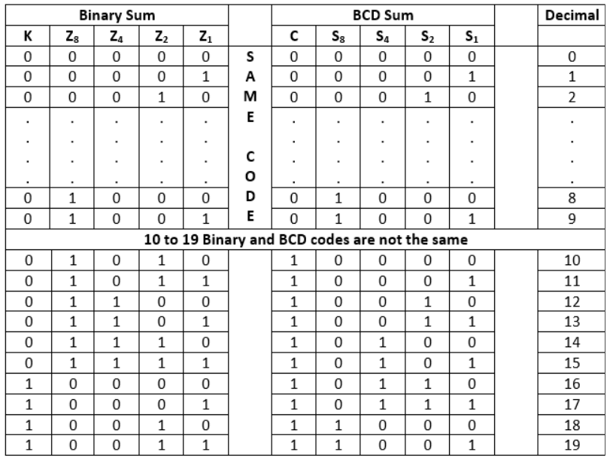
Decimal or BCD Adder cont…

Slide 25

Decimal or BCD Adder cont…
From the above table, it is clear that if the produced sum is between 1 to 9, the Binary and the BCD code is the same. But for 10 to 19 decimal numbers, both the codes are different. In the above table, the binary sum combinations from 10 to 19 give invalid BCD. There are the following points that help the circuit to identify the invalid BCD.
It is obvious from the table that a correction is needed when the 'Binary Sum' has an output carry K=1.
The other six combinations from 10 to 15 need correction in which the bit on the Z₈ position is 1.
In the Binary sum of 8 and 9, the bit on the Z₈ position is also 1. So, the second step fails, and we need to modify it.
To distinguish these two numbers, we specify that the bit on the Z₄ or Z₂ position also needs to be 1 with the bit of Z₈
The condition for a correction and an output carry can be expressed by the Boolean function:

Slide 26
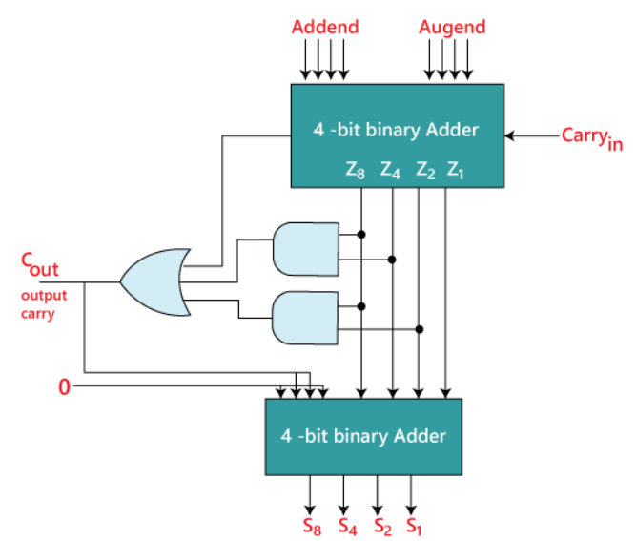
Decimal or BCD Adder cont…

Slide 27
Decimal or BCD Adder cont…
Example:
3 8
+ 4 7
3 8
+ 4 7
7 F
+ 0 6
8 5
Decimal Addition
8 5
BCD Addition

